Slide 1
LESSON 10-1 Accounting for Sales on Account
Learning Objectives
LO1 Explain the relationship between the accounts receivable ledger and its controlling account.
LO2 Record sales on account using a sales journal.

Slide 2
Subsidiary Ledgers and Controlling Accounts
Lesson 10-1
LO1
The amount a business receives from the sale of an item of merchandise is called the selling price.
The amount a business adds to the cost of merchandise to establish the selling price is called markup.
An accounts receivable ledger is a subsidiary ledger containing all accounts for charge customers.
SLIDE 2

Slide 3
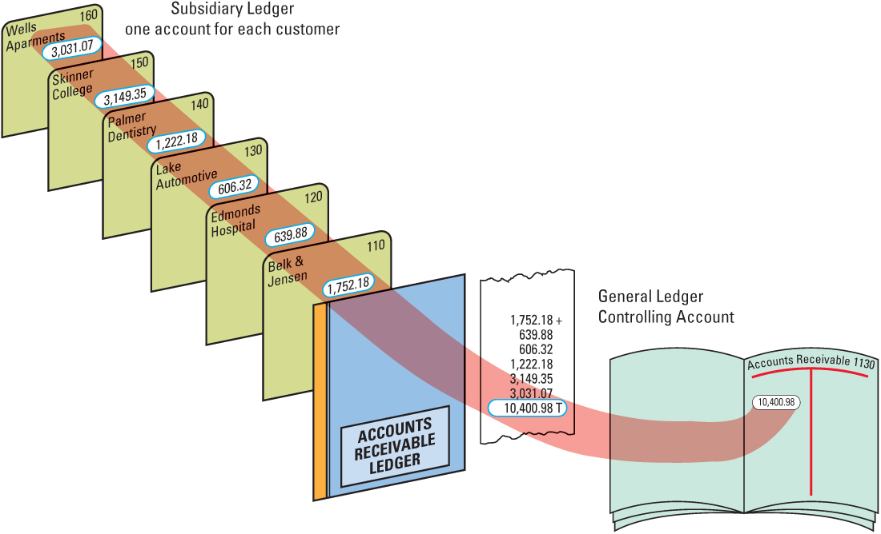
Subsidiary Ledgers and Controlling Accounts
Lesson 10-1
LO1
SLIDE 3

Slide 4
Subsidiary Ledger Form
Lesson 10-1
LO1
1
Account Name
2
Account Number
Date
3
4
Balance
5
Check Mark
6
Account Balance
Same column headings
SLIDE 4

Slide 5
Sales Tax
Lesson 10-1
LO2
A tax on a sale of merchandise or services is called a sales tax.
SLIDE 5

Slide 6
Sales Journal
Lesson 10-1
LO2
A sales journal is a special journal used to record only sales of merchandise on account.
SLIDE 6

Slide 7
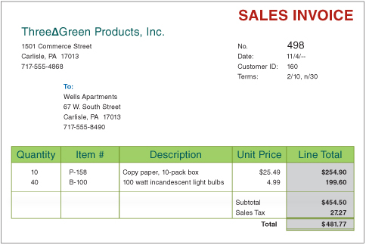
Sales Invoice
Lesson 10-1
LO2
SLIDE 7

Slide 8
Sale on Account
Lesson 10-1
LO2
November 4. Sold merchandise on account to Wells Apartments, $454.50, plus sales tax, $27.27; total, $481.77. Sales Invoice No. 498.
Accounts Receivable
481.77
Sales
454.50
Sales Tax Payable
1
Date
2
Customer Name
3
Sales Invoice Number
27.27
Total Amount Owed by Customer
4
5
Sales
6
Sales Tax
SLIDE 8

Slide 9
Lesson 10-1 Audit Your Understanding
Lesson 10-1
1. How are selling price and markup related?
ANSWER
Markup is the amount added to the cost of merchandise to set the selling price.
SLIDE 9

Slide 10
Lesson 10-1 Audit Your Understanding
Lesson 10-1
2. What is the relationship between the accounts receivable ledger and its controlling account?
ANSWER
The total of the accounts in the accounts receivable subsidiary ledger equals the balance in the controlling account, Accounts Receivable.
SLIDE 10

Slide 11
Lesson 10-1 Audit Your Understanding
Lesson 10-1
3. What column on a general ledger form is not on an accounts receivable ledger form?
ANSWER
Credit Balance
SLIDE 11

Slide 12
Lesson 10-1 Audit Your Understanding
Lesson 10-1
4. What is the title of the general ledger account used to summarize the total amount due from all charge customers?
ANSWER
Accounts Receivable
SLIDE 12

Slide 13
Lesson 10-1 Audit Your Understanding
Lesson 10-1
5. How are sales tax rates usually stated?
ANSWER
As a percent of sales
SLIDE 13

Slide 14
Lesson 10-1 Audit Your Understanding
Lesson 10-1
6. Why is sales tax collected considered a liability?
ANSWER
The amount of sales tax collected is a business liability until paid to the government.
SLIDE 14

