Slide 1
LESSON 11-2 Recording Sales Transactions Using a General Journal
Learning Objectives
LO4 Account for sales returns and allowances.
LO5 Post a general journal to the accounts receivable ledger and general ledger.
LO6 Record a correcting entry to the accounts receivable ledger.

Slide 2
Credit Memorandum for Sales Returns and Allowances
Lesson 11-2
LO4
Credit allowed to a customer for the sales price of returned merchandise, resulting in a decrease in the accounts receivable of the merchandising business, is called a sales return.
Credit allowed to a customer for part of the sales price of merchandise that is not returned, resulting in a decrease in the accounts receivable of the merchandising business, is called a sales allowance.
A form prepared by the vendor showing the amount deducted for returns and allowances is called a credit memorandum.
SLIDE 2

Slide 3
Credit Memorandum for Sales Returns and Allowances
Lesson 11-2
LO4
SLIDE 3

Slide 4
Journalizing Sales Returns and Allowances
Lesson 11-2
LO4
December 16. Granted credit to Lake Automotive for merchandise returned, $65.85, plus sales tax, $3.95, from S500; total, $69.80. Credit Memorandum No. 14.
Sales Returns and Allowances
65.85
Sales Tax Payable
1
Date
Credit Memorandum Number
3
3.95
2
First Debit Account Title
Accounts Receivable
Diagonal Line
69.80
5
Second Debit Account Title
8
6
Sales Tax Amount
7
Credit Account Titles
Sales Return Amount
4
9
Total Amount of Return
SLIDE 4

Slide 5
Posting from a General Journal to an Accounts Receivable Ledger
Lesson 11-2
LO5
Date
1
Journal Page Number
2
Customer Number
5
3
Credit
4
Account Balance
SLIDE 5

Slide 6
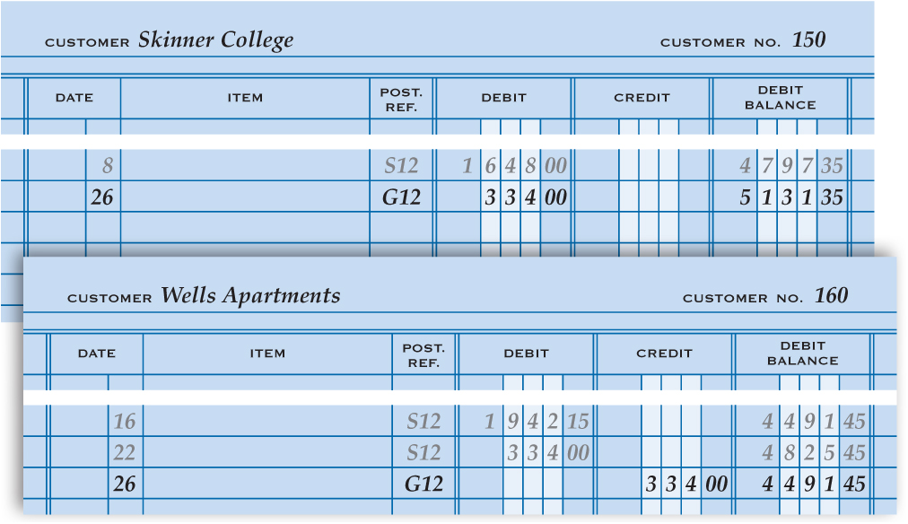
Correcting Errors in Subsidiary Ledger Accounts
Lesson 11-2
LO6
December 26. Found that a sale on account to Skinner College was incorrectly charged to the account of Wells Apartments, $334.00. Memorandum No. 44.
1. Write the date.
2. Write the name of the correct customer.
3. Write the memorandum number.
8
4. Write the amount in the Debit column.
4
5. Indent and write the name of the incorrectly charged customer.
1
2
3
6
5
11
6. Write the amount in the Credit column.
11
7. Write the date in the Date column of each customer account.
8. Write the general journal page number in the Post. Ref. column of each customer account.
7
8
9
10
11
9. Write the amount of the appropriate Debit or Credit.
10. Calculate and write the new account balance.
7
8
9
10
11. Write the customer numbers.
SLIDE 6

Slide 7
Lesson 11-2 Audit Your Understanding
Lesson 11-2
1. What is the difference between a sales return and a sales allowance?
ANSWER
A sales return is credit allowed to a customer for the sales price of returned merchandise. A sales allowance is credit allowed to a customer for part of the sales price of merchandise that is not returned, such as for a shortage in a shipment.
SLIDE 7

Slide 8
Lesson 11-2 Audit Your Understanding
Lesson 11-2
2. What is the source document for journalizing sales returns and allowances?
ANSWER
Credit memorandum
SLIDE 8

Slide 9
Lesson 11-2 Audit Your Understanding
Lesson 11-2
3. Why are sales returns and allowances not debited to the Sales account?
ANSWER
To provide better information, enabling management to quickly learn if the percent of sales returns and allowances to sales is greater than expected
SLIDE 9

Slide 10
Lesson 11-2 Audit Your Understanding
Lesson 11-2
4. Which general ledger accounts are affected, and how, by a sales returns and allowances transaction?
ANSWER
Sales Returns and Allowances and Sales Tax Payable are debited; Accounts Receivable is credited.
SLIDE 10

