Slide 1
LESSON 15-1 Planning Adjusting Entries
Learning Objectives
LO1 Prepare an unadjusted trial balance.
LO2 Adjust supplies and prepaid insurance.

Slide 2
Adjusting Account Balances
Lesson 15-1
LO1
Some general ledger accounts need to be brought up to date before financial statements are prepared.
Adjusting entries are used to bring a general ledger account up to date.
SLIDE 2

Slide 3
Preparing an Unadjusted Trial Balance
Lesson 15-1
LO1
The first step in preparing adjusting entries is to prepare a trial balance.
A trial balance prepared before adjusting entries are posted is called an unadjusted trial balance.
SLIDE 3

Slide 4
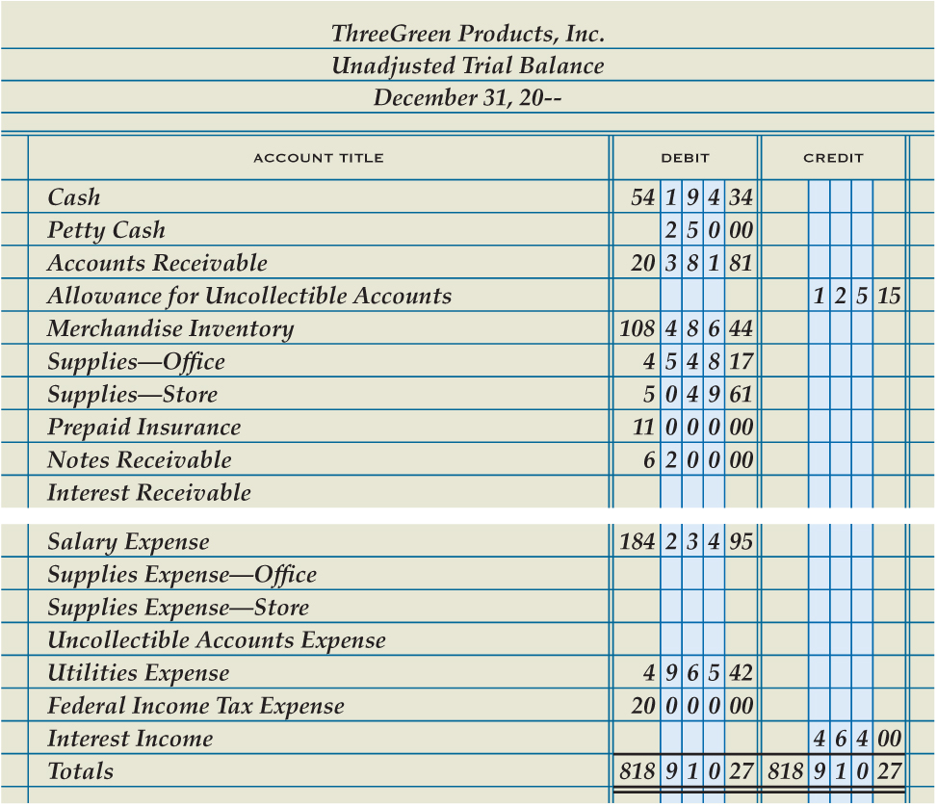
Preparing an Unadjusted Trial Balance
Lesson 15-1
LO1
1
Write account titles
2
Enter account balances
3
Total, prove, and rule column totals
SLIDE 4

Slide 5
Recording Adjusting Entries for Supplies
Lesson 15-1
LO2
Four questions are asked to analyze the adjustments for supplies.
What are the balances of the accounts being adjusted?
What should the balances be for these accounts?
What must be done to correct the account balances?
What adjusting entries are made?
SLIDE 5

Slide 6
Recording Adjusting Entries for Supplies
Lesson 15-1
LO2
Supplies Expense—Office
Adj. 3,938.17
Supplies—Office
Dec. 31 Bal. 4,548.17
(New Bal. 610.00)
Adj. 3,938.17
Supplies Expense—Store
Adj. 4,584.61
Supplies—Store
Dec. 31 Bal. 5,049.61
(New Bal. 465.00)
Adj. 4,584.61
SLIDE 6

Slide 7
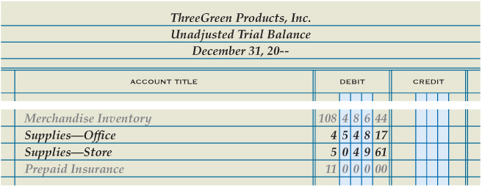
Recording Adjusting Entries for Supplies
Lesson 15-1
LO2
Debit Supplies Expense—Store
1
Debit Supplies Expense—Office
3
2
Credit Supplies—Office
4
Credit Supplies—Store
SLIDE 7

Slide 8
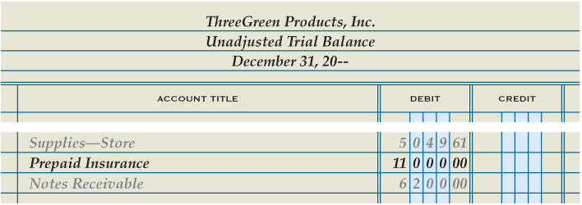
Recording an Adjusting Entry for Prepaid Insurance
Lesson 15-1
LO2
Insurance Expense
Adj. 8,200.00
Prepaid Insurance
Dec. 31 Bal. 11,000.00
(New Bal. 2,800.00)
Adj. 8,200.00
1
Debit Insurance Expense
2
Credit Prepaid Insurance
SLIDE 8

Slide 9
Lesson 15-1 Audit Your Understanding
Lesson 15-1
1. Which adjusting entry is unique to a corporation?
ANSWER
Federal income tax expense
SLIDE 9

Slide 10
Lesson 15-1 Audit Your Understanding
Lesson 15-1
2. What four questions are used to analyze the adjustment of an account?
ANSWER
1. What is the balance of the account being adjusted?
2. What should the balance be for this account?
3. What must be done to correct the account balance?
4. What adjustment is made?
SLIDE 10

Slide 11
Lesson 15-1 Audit Your Understanding
Lesson 15-1
3. Which accounts are used for the adjustment to office supplies?
ANSWER
Supplies Expense—Office
Supplies—Office
SLIDE 11

Slide 12
Lesson 15-1 Audit Your Understanding
Lesson 15-1
4. Which accounts are used for the adjustment to prepaid insurance?
ANSWER
Insurance Expense
Prepaid Insurance
SLIDE 12

