Slide 1
LESSON 15-2 Adjusting Merchandise Inventory and Interest Receivable
Learning Objectives
LO3 Adjust merchandise inventory.
LO4 Adjust interest receivable.

Slide 2
Recording an Adjusting Entry for Merchandise Inventory
Lesson 15-2
LO3
The amount of inventory on hand at the beginning of a fiscal period is called beginning inventory.
During the period, merchandise is purchased and merchandise is sold.
To determine how much merchandise remains in inventory at the end of the period, a physical inventory is conducted.
The actual count of merchandise at the end of a fiscal period is called ending inventory.
SLIDE 2

Slide 3
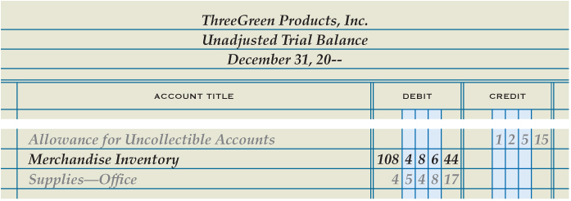
Recording an Adjusting Entry for Merchandise Inventory
Lesson 15-2
LO3
Merchandise Inventory
Dec. 31 Bal. 108,486.44
(New Bal. 102,838.00)
Adj. 5,648.44
Income Summary
Adj. 5,648.44
1
Debit Income Summary
2
Credit Merchandise Inventory
SLIDE 3

Slide 4
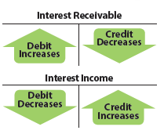
Journalizing the Adjusting Entry for Interest Receivable
Lesson 15-2
LO4
Interest earned but not yet received is called accrued interest income.
SLIDE 4

Slide 5
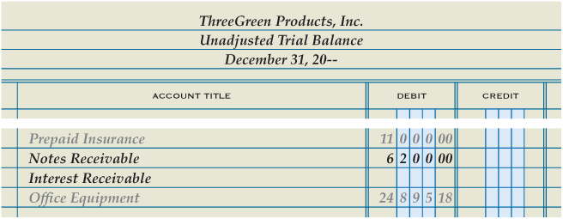
Journalizing the Adjusting Entry for Interest Receivable
Lesson 15-2
LO4
Interest Expense
Adj. 93.00
Interest Income
Dec. 31 Bal. 464.00
New Bal. 93.00
(New Bal. 557.00)
1
Debit Interest Receivable
2
Credit Interest Income
SLIDE 5

Slide 6
Lesson 15-2 Audit Your Understanding
Lesson 15-2
1. How is the amount of merchandise inventory on hand at the end of the fiscal year determined?
ANSWER
A physical inventory is conducted.
SLIDE 6

Slide 7
Lesson 15-2 Audit Your Understanding
Lesson 15-2
2. What adjusting entry is recorded when the ending merchandise inventory is greater than the beginning value?
ANSWER
Debit Merchandise Inventory
Credit Income Summary
SLIDE 7

Slide 8
Lesson 15-2 Audit Your Understanding
Lesson 15-2
3. How often is revenue earned on an outstanding note receivable?
ANSWER
Daily
SLIDE 8

Slide 9
Lesson 15-2 Audit Your Understanding
Lesson 15-2
4. What types of accounts are increased by recording an adjusting entry for accrued revenue?
ANSWER
The adjusting entry for accrued revenue increases a revenue account (a credit) and increases a receivable account (a debit).
SLIDE 9

