Slide 1
LESSON 15-3 Adjusting Accumulated Depreciation
Learning Objectives
LO5 Calculate depreciation expense using the straight-line method.
LO6 Adjust accumulated depreciation.

Slide 2
Categories of Assets
Lesson 15-3
LO5
Most businesses use several broad categories of assets in their operations.
Cash and other assets expected to be exchanged for cash or consumed within a year are called current assets.
Physical assets that will be used for a number of years in the operation of a business are called plant assets.
SLIDE 2

Slide 3
Depreciating Plant Assets
Lesson 15-3
LO5
A loss in the usefulness of a plant asset as a result of wear or obsolescence is called depreciation.
To match revenue with the expenses used to earn the revenue, the cost of a plant asset must be expensed over the asset’s useful life.
The portion of a plant asset’s cost that is transferred to an expense account in each fiscal period during that asset’s useful life is called depreciation expense.
SLIDE 3

Slide 4
Depreciating Plant Assets
Lesson 15-3
LO5
Three factors are considered in calculating the annual amount of depreciation expense for a plant asset:
Original cost
Salvage value
Useful life
SLIDE 4

Slide 5
Depreciating Plant Assets—Original Cost
Lesson 15-3
LO5
The original cost of a plant asset includes all costs paid to make the asset usable to a business.
These costs include the price of the asset plus delivery and any necessary installation costs.
SLIDE 5

Slide 6
Depreciating Plant Assets—Salvage Value
Lesson 15-3
LO5
An estimate of the amount that will be received for an asset at the time of its disposal is called its salvage value.
Salvage value may also be referred to as residual value or scrap value.
Since salvage value cannot be known when the asset is bought, it must be estimated.
SLIDE 6

Slide 7
Depreciating Plant Assets—Useful Life
Lesson 15-3
LO5
The period of time over which an asset contributes to the earnings of a business is called its useful life.
The total amount of depreciation expense is distributed over the estimated useful life of a plant asset.
Two factors affect the useful life of a plant asset:
Physical depreciation
Functional depreciation
SLIDE 7

Slide 8
Straight-line Depreciation
Lesson 15-3
LO5
Recording an equal amount of depreciation expense for a plant asset in each year of its useful life is called the straight-line method of depreciation.
Original Cost | − | Estimated Salvage Value | = | Estimated Total Depreciation Expense
$2,500.00 | − | $500.00 | = | $2,000.00
Estimated Total Depreciation Expense | ÷ | Years of Estimated Useful Life | = | Annual Depreciation Expense
$2,000.00 | ÷ | 5 | = | $400.00
SLIDE 8

Slide 9
Accumulated Depreciation
Lesson 15-3
LO6
The total amount of depreciation expense that has been recorded since the purchase of a plant asset is called accumulated depreciation.
20X2 Accumulated Depreciation | + | 20X3 Depreciation Expense | = | 20X3 Accumulated Depreciation
$800.00 | + | $400.00 | = | $1,200.00
SLIDE 9

Slide 10
Book Value
Lesson 15-3
LO6
The original cost of a plant asset minus accumulated depreciation is called the book value of a plant asset.
Original Cost | − | 20X3 Accumulated Depreciation | = | Ending 20X3 Book Value
$2,500.00 | − | $1,200.00 | = | $1,300.00
SLIDE 10

Slide 11
Journalizing the Adjusting Entry for Accumulated Depreciation
Lesson 15-3
LO6
Office Equipment
Dec. 31 Bal. 24,895.18
Depreciation Expense—Office Equipment
Adj. 7,485.00
Accumulated Depreciation—Office Equipment
Dec. 31 Bal. 6,189.00
Adj. 7,485.00
(New Bal. 13,674.00)
Store Equipment
Dec. 31 Bal. 59,148.11
Depreciation Expense—Store Equipment
Adj. 9,830.00
Accumulated Depreciation—Store Equipment
Dec. 31 Bal. 8,495.00
Adj. 9,830.00
(New Bal. 18,325.00)
SLIDE 11

Slide 12
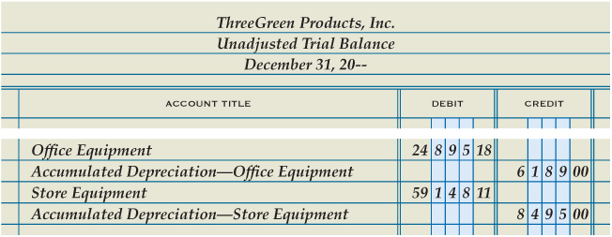
Journalizing the Adjusting Entry for Accumulated Depreciation
Lesson 15-3
LO6
Debit Depreciation Expense—Office Equipment and credit Accumulated Depreciation—Office Equipment
Debit Depreciation Expense—Store Equipment and credit Accumulated Depreciation—Store Equipment
1
2
SLIDE 12

Slide 13
Lesson 15-3 Audit Your Understanding
Lesson 15-3
1. What are two categories of assets?
ANSWER
Current assets
Plant assets
SLIDE 13

Slide 14
Lesson 15-3 Audit Your Understanding
Lesson 15-3
2. What three factors are used to calculate a plant asset’s annual depreciation expense?
ANSWER
Original cost, salvage value, and useful life
SLIDE 14

Slide 15
Lesson 15-3 Audit Your Understanding
Lesson 15-3
3. What plant asset account does not have a contra account for accumulated depreciation?
ANSWER
Land
SLIDE 15

Slide 16
Lesson 15-3 Audit Your Understanding
Lesson 15-3
4. How does an adjusting entry for accumulated depreciation affect the related plant asset account?
ANSWER
No change
SLIDE 16

