Slide 1
LESSON 17-2 Vertical Analysis of a Balance Sheet
Learning Objectives
LO2 Perform vertical analysis of a balance sheet.
LO3 Analyze a balance sheet using vertical analysis.

Slide 2
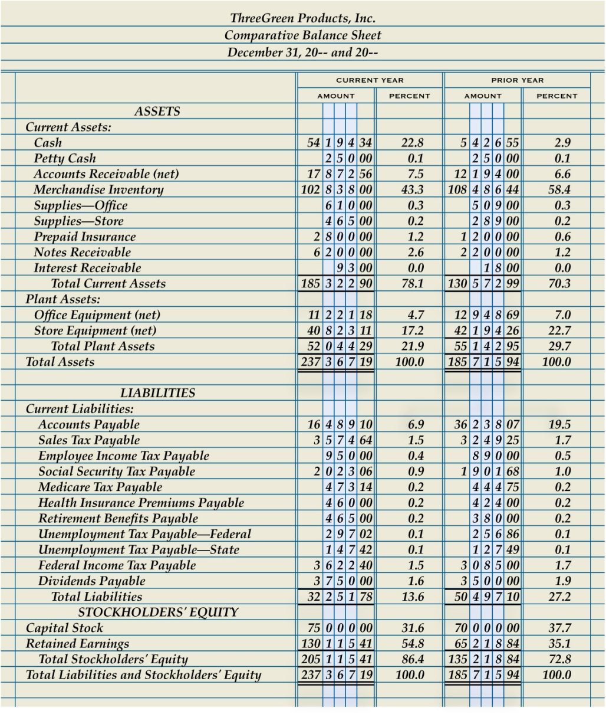
Calculating Vertical Analysis Ratios on a Balance Sheet
Lesson 17-2
LO2
1
Asset Amounts Divided by Total Assets
2
Liability and Stockholders’ Equity Amounts Divided by Total Assets
SLIDE 2

Slide 3
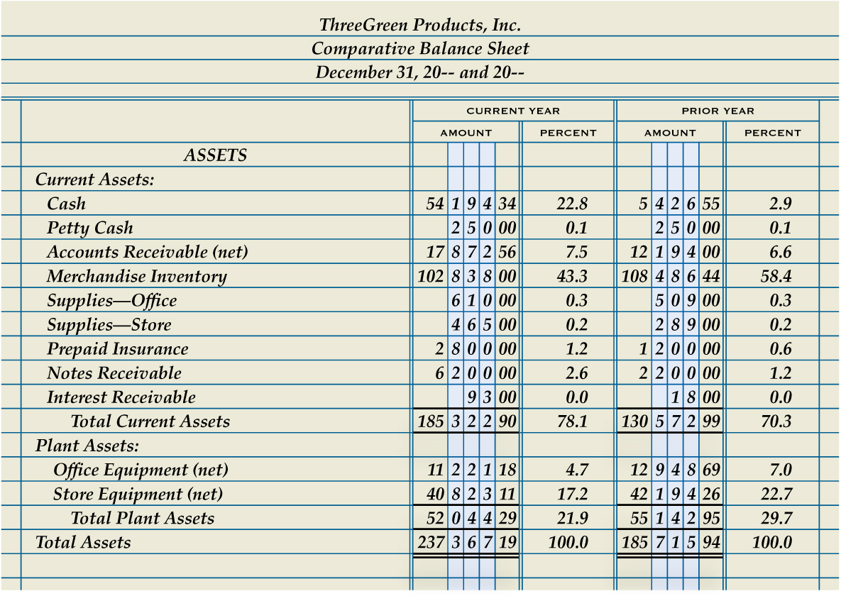
Evaluating Vertical Analysis Asset Ratios
Lesson 17-2
LO3
SLIDE 3

Slide 4
Evaluating Vertical Analysis Liability Ratios
Lesson 17-2
LO3
A ratio that measures the ability of a business to pay its long-term liabilities is called a solvency ratio.
Total liabilities divided by total assets is called the debt ratio.
SLIDE 4

Slide 5
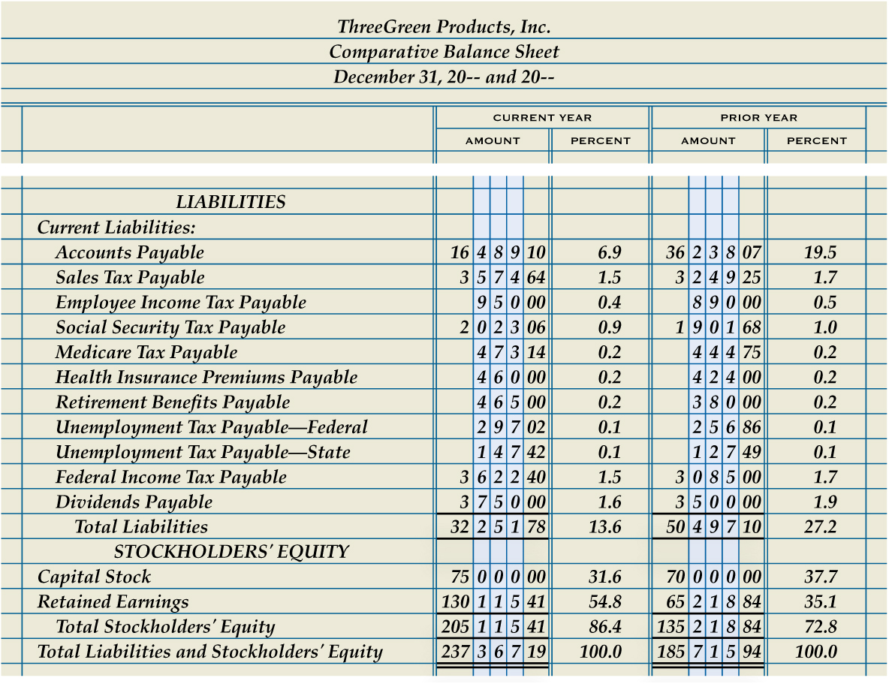
Evaluating Vertical Analysis Liability Ratios
Lesson 17-2
LO3
SLIDE 5

Slide 6
Lesson 17-2 Audit Your Understanding
Lesson 17-2
1. Why do many retailers perform vertical analysis on the Accounts Receivable and Merchandise Inventory accounts?
ANSWER
First, these are typically two of the largest asset accounts for a retail merchandising business.
Second, industry standards are available for these accounts.
SLIDE 6

Slide 7
Lesson 17-2 Audit Your Understanding
Lesson 17-2
2. What may cause a vertical analysis ratio for accounts receivable to be below the target range?
ANSWER
A ratio below the target range may indicate that a company is restricting customers’ ability to purchase on account. This action may have a negative effect on sales.
SLIDE 7

Slide 8
Lesson 17-2 Audit Your Understanding
Lesson 17-2
3. What may cause a vertical analysis ratio for merchandise inventory to be below the target range?
ANSWER
The business may not be stocking an adequate supply or variety of merchandise.
SLIDE 8

Slide 9
Lesson 17-2 Audit Your Understanding
Lesson 17-2
4. What should a company do if the vertical analysis ratio for merchandise inventory is above the target range?
ANSWER
The company should prepare a list of the inventory items having the largest cost. The company should assess whether the proper quantity of each item is available for sale. Future inventory purchases should ensure that the optimal quantity on hand is maintained.
SLIDE 9

Slide 10
Lesson 17-2 Audit Your Understanding
Lesson 17-2
5. Why is it risky for a business to have too many liabilities?
ANSWER
The business must be able to pay its liabilities on a timely basis. If sales decline during difficult financial times, a business may be unable to make its monthly payments.
SLIDE 10

