Slide 1
LESSON 19-3 Journalizing Depreciation Expense
Learning Objectives
LO7 Prepare plant asset records.
LO8 Journalize annual depreciation expense.

Slide 2
Preparing Plant Asset Records
Lesson 19-3
LO7
An accounting form on which a business records information about each plant asset is called a plant asset record.
SLIDE 2

Slide 3
Content of Plant Asset Records
Lesson 19-3
LO7
Most plant asset records contain similar information.
Section 1 is prepared when a plant asset is bought.
Section 2 provides space for recording the disposition of the plant asset. When the asset is disposed of, this information will be filled in.
Section 3 provides space for recording annual depreciation expense and the changing book value of the asset each year it is used.
SLIDE 3

Slide 4
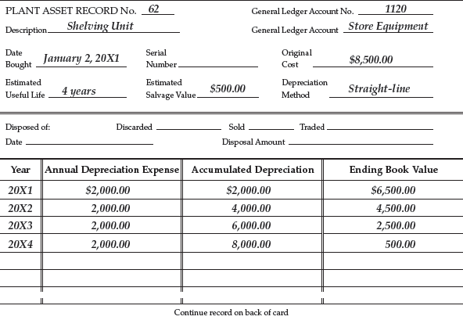
Preparing Plant Asset Records
Lesson 19-3
LO7
Write the information in Section 1 when the plant asset is bought.
1
Do not write in Section 2 until the asset is disposed of.
2
3
Each year the asset is owned, record the year’s annual depreciation expense in Section 3. Calculate and record accumulated depreciation and ending book value.
SLIDE 4

Slide 5
Journalizing Annual Depreciation Expense
Lesson 19-3
LO8
Office Equipment
Dec. 31 Bal. 325,648.16
Depreciation Expense—Office Equipment
Dec. 31 Adj. 25,146.00
Accumulated Depreciation—Office Equipment
Dec. 31 Bal. 79,727.00
Dec. 31 Adj. 25,146.00
(Dec. 31 Bal. 104,873.00)
SLIDE 5

Slide 6
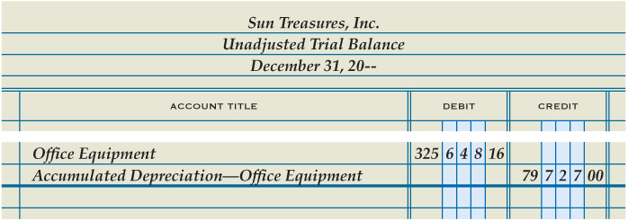
Journalizing Annual Depreciation Expense
Lesson 19-3
LO8
1
Debit Depreciation Expense
2
Credit Accumulated Depreciation
SLIDE 6

Slide 7
Lesson 19-3 Audit Your Understanding
Lesson 19-3
1. How is accumulated depreciation recorded so as to retain the original cost information for plant assets?
ANSWER
Depreciation is credited to the contra account, Accumulated Depreciation, rather than crediting the asset account.
SLIDE 7

Slide 8
Lesson 19-3 Audit Your Understanding
Lesson 19-3
2. How does an adjusting entry for depreciation expense change the balance of the asset account?
ANSWER
The balance of the asset account is not changed.
SLIDE 8

